Slide 1


AI & Cybersecurity

Slide 2
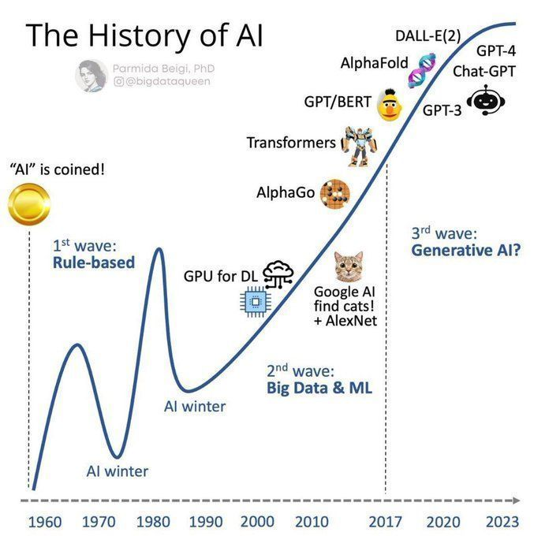
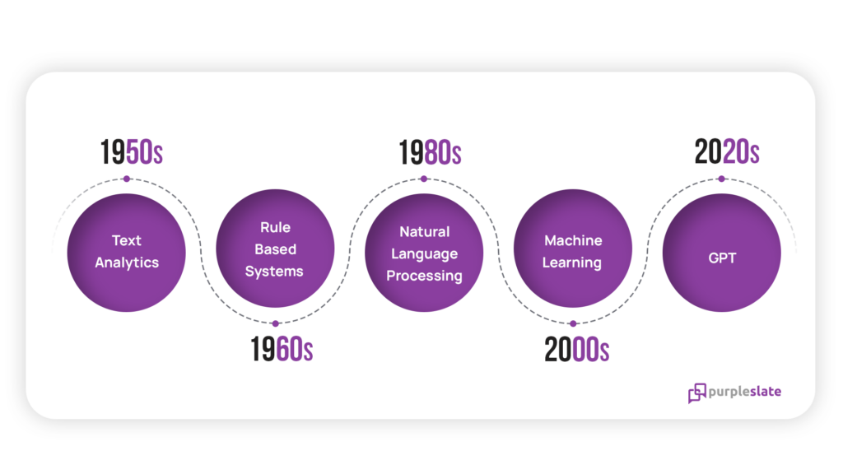
Brief history of ai
Source: https://www.purpleslate.com/generative-ai-guide/
Source: https://www.parmidabeigi.com/
https://x.com/AndrewinContact/status/1744691198378266747

Slide 3
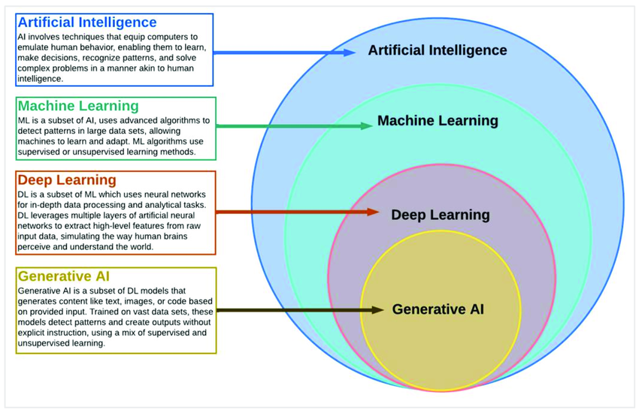
Artificial intelligence fundamentals
Source: https://www.mdpi.com/2071-1050/15/18/13484

Slide 4
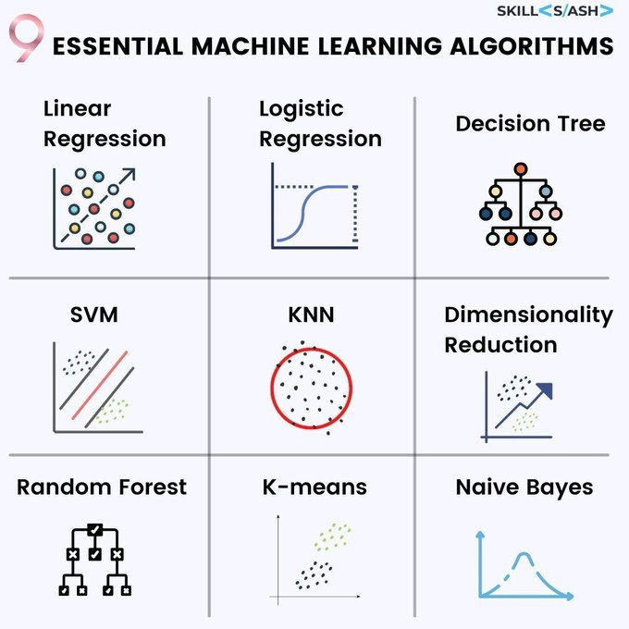
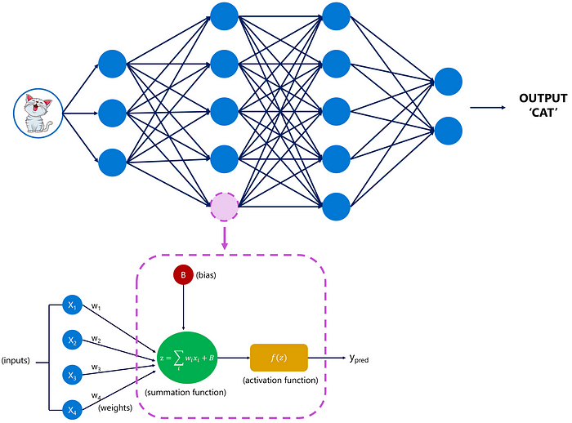
Machine Learning Algorithms
Source: https://medium.com/@margauxvanderplaetsen/ the-journey-and-architecture-of-chatgpt-a-look-behind-the-scenes-ef35bed11072
Source: https://www.skillslash.com/
https://x.com/RealSaintSteven/status/1585330168930787329

Slide 5
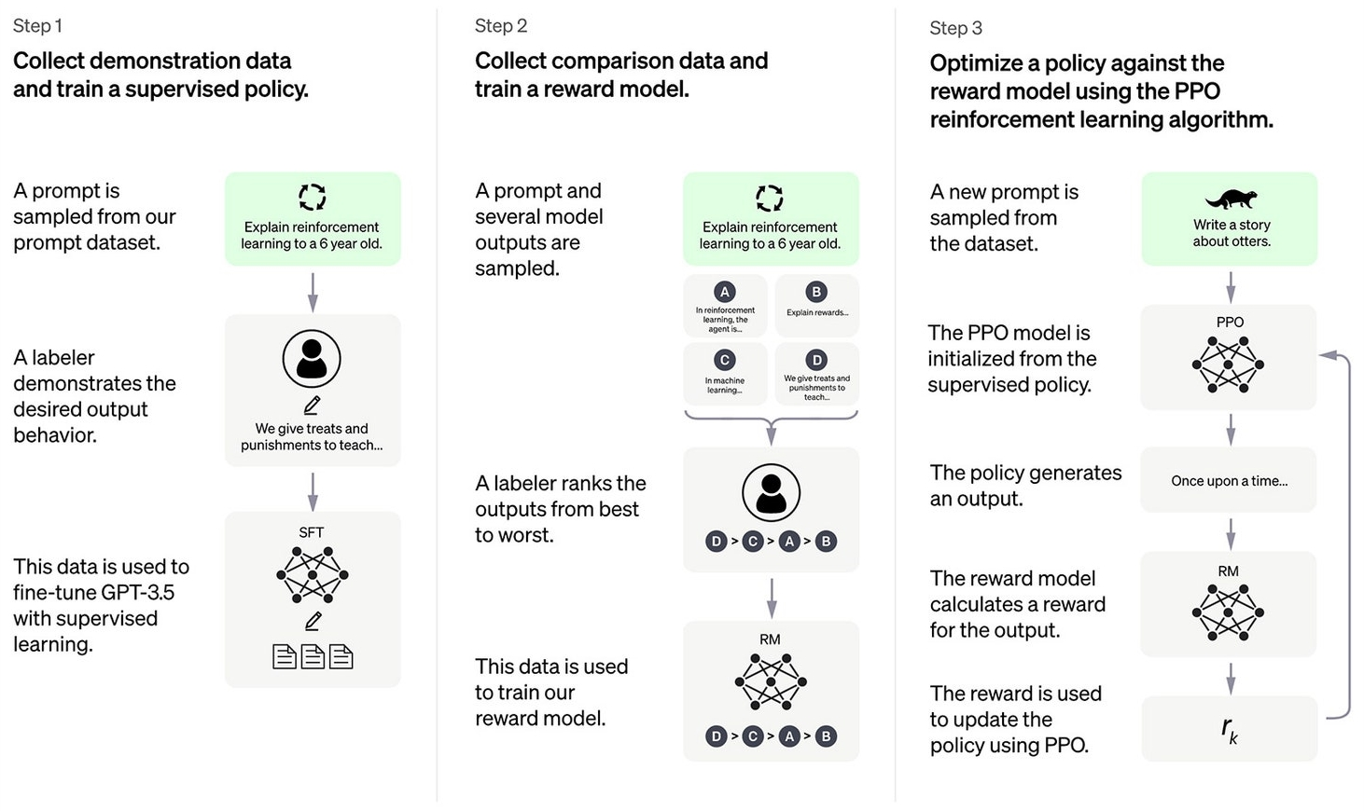
TRAINING CHATGPT
Source: https://openai.com/index/chatgpt/

Slide 6

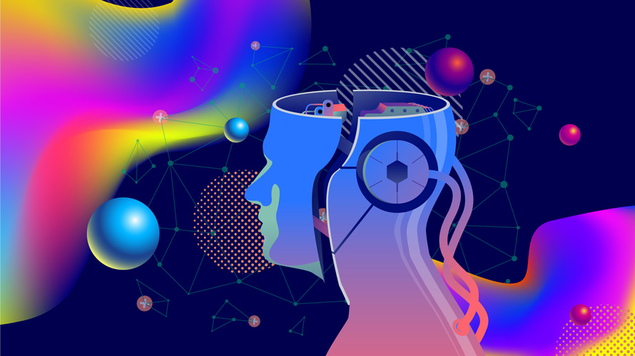
AI for studying
Create a study plan
Summarize notes/videos
Gamma, ChatGPT, Fabric
Quiz yourself

Slide 7

Gen AI for OSINT
Cleanup.pictures
Picwish.com
Phind.com

Slide 8
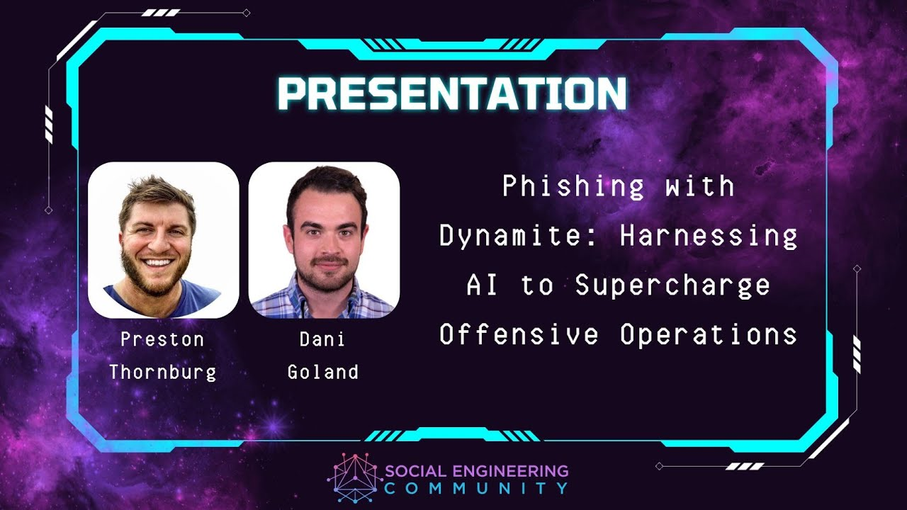
AI for phishing?

Slide 9
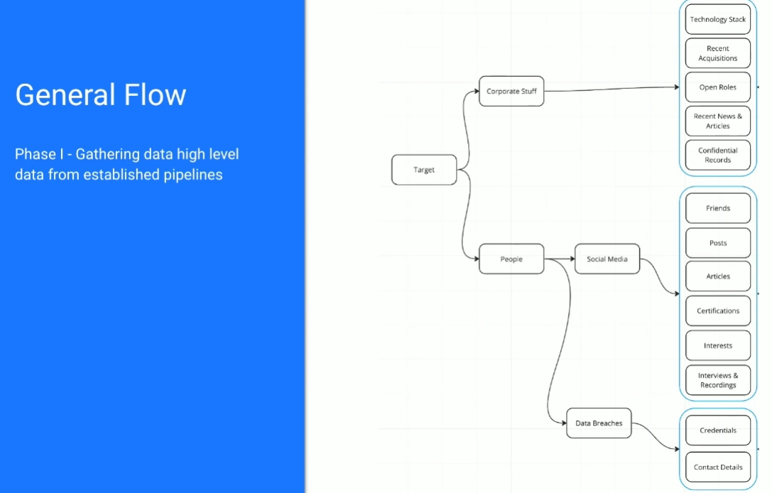
AI for phishing?

Slide 10
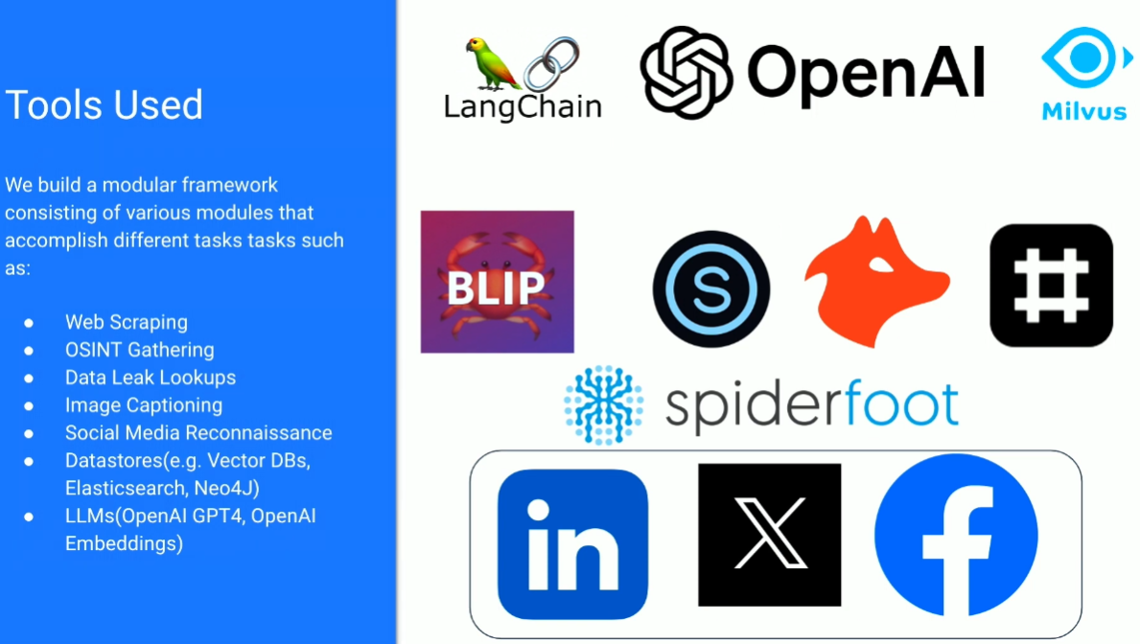
AI for phishing?

Slide 11
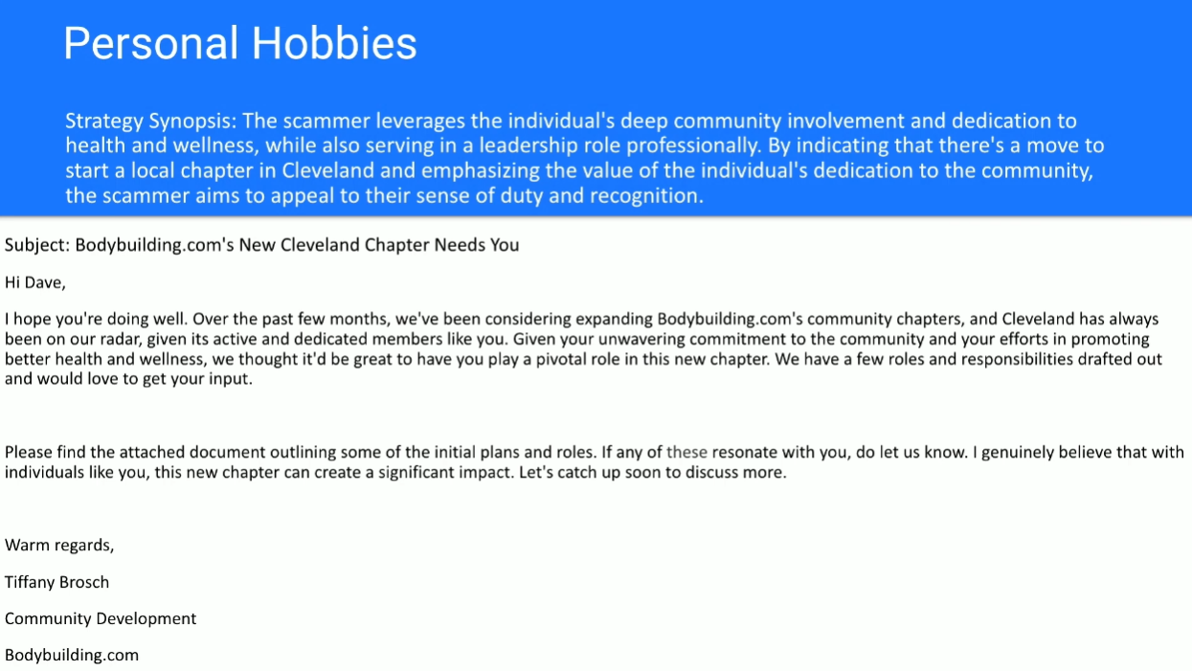

Slide 12

Risks and Considerations
Be aware what you can and cannot use!
Privacy & Data storage
Accuracy
Ethical Implications

Slide 13
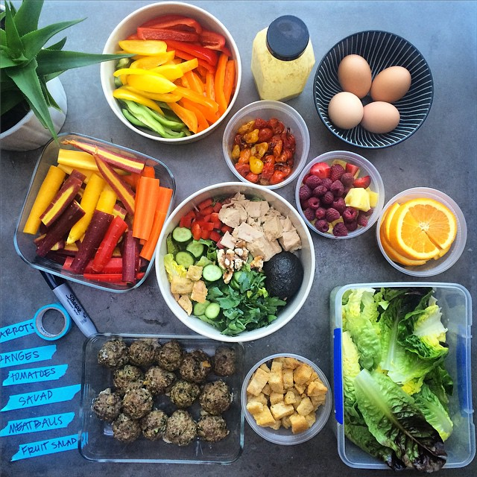
AI Meal Planning for Broke College Students
Chat GPT integration with Instacart streamlines shopping.
AI analyzes preferences and suggests high-protein options.
Offers recipe suggestions tailored to dietary needs and budget.
Turned 2 hours into 2 minutes .
Real-time inventory updates ensure items are in stock.
ThePhoto by PhotoAuthor is licensed under CCYYSA.

Slide 14

AI Weekly Task Organization
AI extracts syllabus tasks and schedules and organizes them by week.
Eliminates 20 minutes of manual organization each week.
Clear and concise overview of weekly tasks.
ThePhoto by PhotoAuthor is licensed under CCYYSA.

Slide 15

BONUS: AI Calendar Integration
AI can input class schedules directly into Google Calendar.
Eliminates the need to manually add each class, saving time.
Reduces risk of scheduling conflicts by automatically accounting for class times.
Ensures that important academic deadlines are not overlooked.
Provides a clear and organized overview of weekly commitments.
ThePhoto by PhotoAuthor is licensed under CCYYSA.

Slide 16
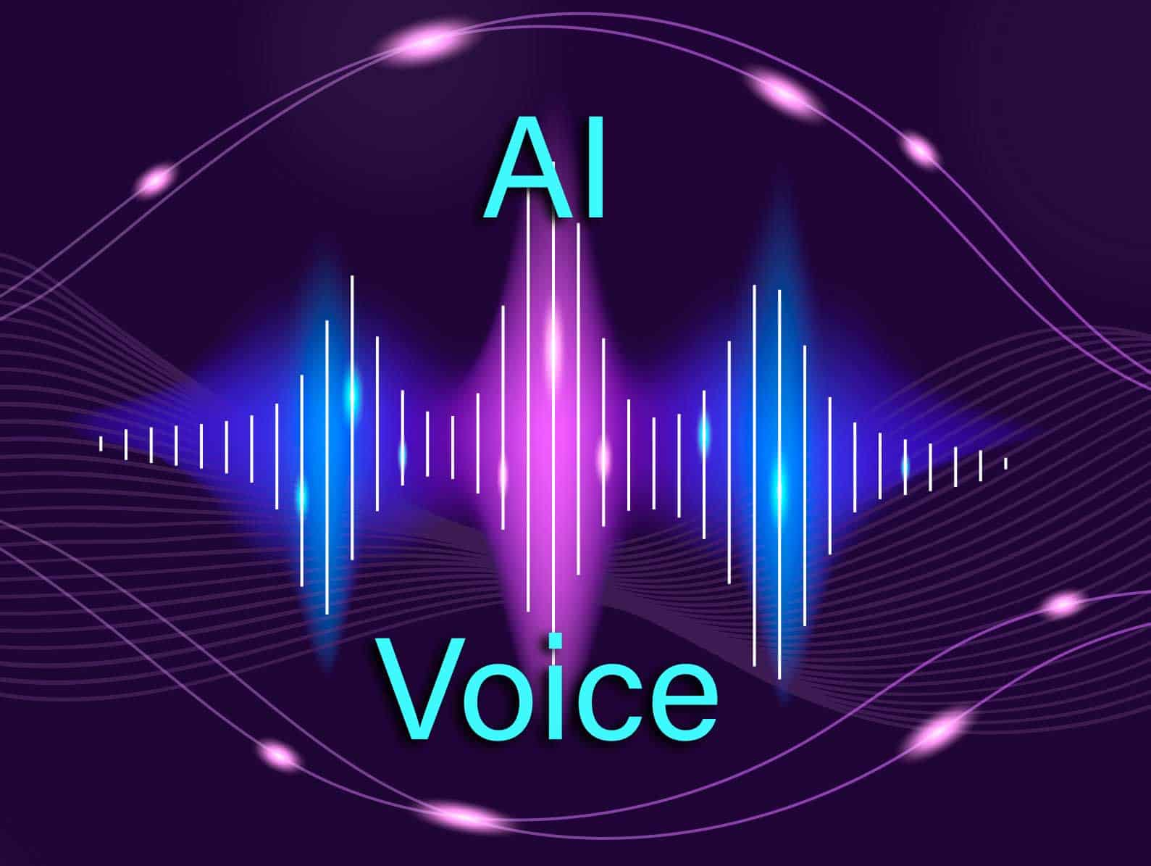
24/7 AI Receptionist for My Business
24/7 AI receptionist service for businesses
Answers customer questions and books appointments
Reduces need for human receptionist, saving labor costs
Frees up staff to focus on other tasks
Provides professional and consistent customer service
ThePhoto by PhotoAuthor is licensed under CCYYSA.

Slide 17
Thank you!

Slide 18



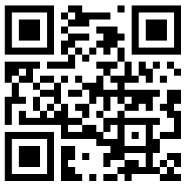
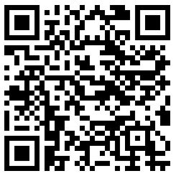
Socials
Discord
INSTAGRAM

Slide 19



Digital Communications
Cloud
Local
Hybrid

